Slide 1
ETL for Big Data

Slide 2
Talend for Big Data
A Graphical Abstraction Layer on top of Hadoop Applications – this makes life so much easy in the Big Data buzz world
Talend is an open source software integration platform/vendor which offers data integration and data management solutions
Features
Unified Platform – provides integration for Big Data and Java
Open Source – can customize to your needs
Native Code – all components are written in Java. Famous for big data integration so it writes MapReduce for you.
Future Proof – If either doing data architecture or data management. Won’t go obsolete anytime soon

Slide 3
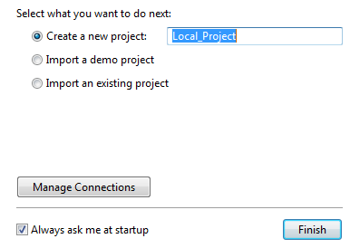
Installation and Launching
Installation
Download the latest version of Talend Big Data from here.
Once the download is complete, extract the archive file on your hard drive.
Launching
Double-click the TOS_BD-win-x86_64.exe executable file to launch your Talend Studio.
As first time user, you need to set up a new project or you can also import a Demo project which gathers numerous job samples.

Slide 4
Installation and Launching
To import a demo project, select Import a demo project and click Finish. In the dialog box that opens, select the project you want to import.
To create a new project, select Create a new project and enter the name of your project in the corresponding field.
Click Finish when complete, to open a welcome window and launch the Studio.
Additional Talend Packages
If additional packages are required to install check Required third-party libraries then click Finish.
Installing External Modules
Talend Studio requires specific third-party Java libraries or database drivers (.jar files) to be installed to connect to sources and targets. Those libraries or drivers, known as external modules, can be required by some of Talend components. Due to license restrictions, Talend may not be able to ship certain external modules within Talend Studio.

Slide 5
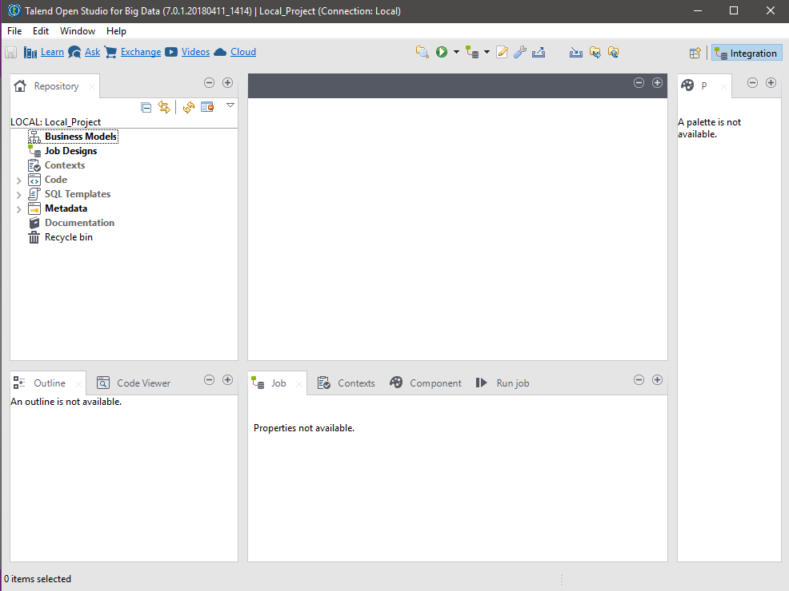
Installation and Launching
At this point, Talend Open Studion for Big Data is installed and ready to use.

Slide 6
Setup
Setting up JAVA_HOME
In order for your Talend product to use the Java environment installed on your machine, you must set the JAVA_HOME environment variable.
Find the folder where Java is installed, usually C:\Program Files\Java\JREx.x.x.
Open the Start menu and type Environment variable in the search bar to open the Environment variable properties.
Click Environment Variables....
Under System Variables, click New... to create a variable. Name the variable JAVA_HOME, enter the path to your Java environment, and click OK.
Under System Variables, select the Path variable, click Edit... and add the following variable at the end of the Path variable value: ;%JAVA_HOME%\bin

Slide 7
Inside Talend Studio
The Talend Open Studio for Big Data interface includes several panels called views.
The Project Repository lists all project items such as Jobs (ETL programs), Contexts, Code, metadata, and project documentation.
The Job Designer is the main view of the studio in which components are used to create ETL jobs.
The Palette lists all available components, organized in folders.
The Component Area displays all parameters to configure a component. Note that the information displayed in this area depends on what is selected in the Job Designer.
The Run View triggers the execution of a Talend Job and displays its results in the console window.

Slide 8
Create a Job
Procedure
Ensure that the Integration perspective is selected.
In the Project Repository, right-click Job Designs.
To open the New Job wizard, click Create Job.
In the Name field of the New Job wizard, fill in the name of the Job as firstETLJob.
In the Purpose field, enter Display a message (optional).
In the Description field, enter This tutorial uses a component to display a message box with a custom message.
To close the wizard and create the job, click Finish.

Slide 9
Adding a Component to Job
Procedure
To add a component, from the Palette select a component from the list.
For example, To add a tMsgBox component, in the Palette, click the Misc.
Click the tMsgBox component and drop it on the Job Designer. This simple test-oriented component displays a message box.
You can also add a component to the Job Designer by placing the mouse pointer in the Job Designer and typing the name of the component that you want to use. When you start typing, a list with matching component names appears. To select a component, double-click the component name.

Slide 10
Configuring a Component
Procedure
In the Job Designer, click the component, for example tMsgBox_1.
To define the Basic settings for the component, in the Components view, click the Component.
Change the "Title" and "Message" fields, change the icon in the dropdown menu.

Slide 11
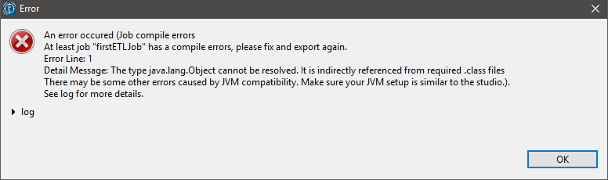
Run Your First Talend Job
Procedure
In the Run view for the Job simpleJob, click Run.
The message box is displayed.
If there is a Java compatibility issue the job may encounter an error like this:

Slide 12
Solving Java Compatibility Issue
Procedure
To verify instated Java version from windows Command Prompt > java –version.
You are required to install a JDK on your machine where Talend Studio is installed, and you must configure the JDK path in Window > References > Java > Installed JRES in Talend Studio before you build jobs.
Assuming the JDK installation path is C:\Program Files\Java\jdkX.X.X follow these steps to configure the JDK path in Talend Studio:
Click Windows, then Preferences, expand Java, and then click Installed JREs.
Click Add to install a new JDK, or click Edit to edit an existing JDK. Browse to the location where your JDK is installed.
Click OK to validate your change and close the window.

Slide 13
Preparing the Metadata
This example describes how to set up the metadata of the source file movies.csv in the Repository. Repository metadata can be used across Jobs, allowing you to configure your Jobs quickly without having to define each parameter and schema manually.
You have the source file movies.csv ready in the directory Documents > Week 08 > Talend_Data > movies.csv
Procedure
In the Repository tree view, expand the Metadata node, right-click File delimited, and select Create file delimited from the contextual menu to open the New Delimited File wizard.
In the New Delimited File wizard, enter a name for the file metadata, movies in this example, and other useful information to better describe your file metadata, and then click Next to go to the next step and define the general properties of the file.
In this step of the wizard, Name is the only mandatory field. The information you provide in the Description field will appear as a tooltip when you move your mouse pointer over the file connection.

Slide 14
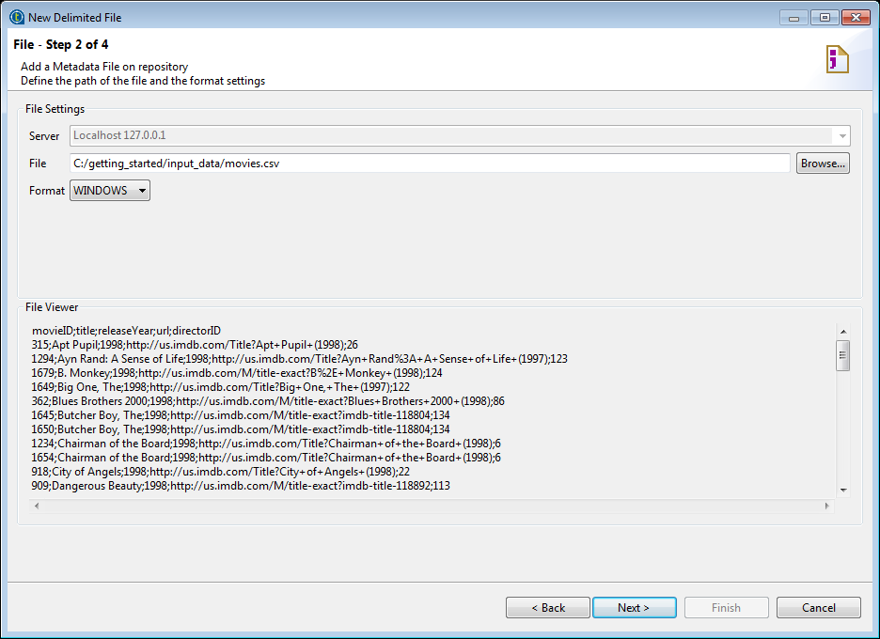
Preparing the Metadata
In the File field specify the path of the source file, or click Browse to browse to the file.
The file is loaded, and the File Viewer area displays an abstract of the file, allowing you to check the file consistency, the presence of header and more generally the file structure.

Slide 15
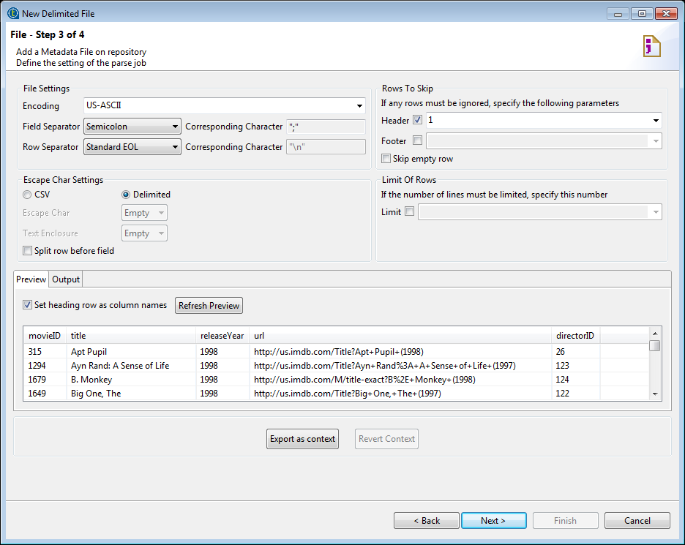
Preparing the Metadata
From the Format list, select your operating system, and click Next to parse the file.
On the Preview tab, select the Set heading row as column names check box to retrieve the file column names from the first row, and then click Refresh Preview.
The file preview is refreshed, and the Header check box in the Rows To Skip area is automatically selected, with the number of header rows to be skipped incremented by 1.

Slide 16
Preparing the Metadata
If the file contains more than one heading row, which need to be skipped in file parsing, specify the number in this field and click Refresh Previewagain.
Click Next to retrieve the file schema.
The Description of the Schema table displays the generated file schema.
Name the schema movies_schema and check the file schema and edit it according to your actual needs.
In this example, increase the length of the title and url columns.

Slide 17
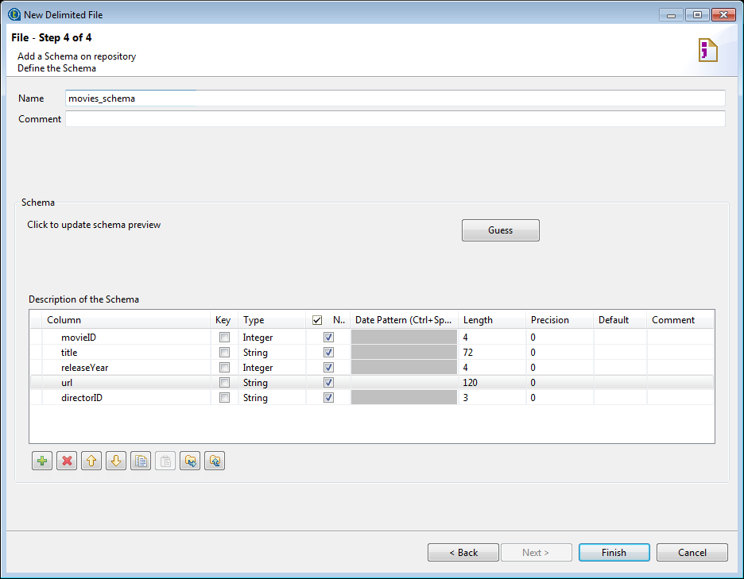
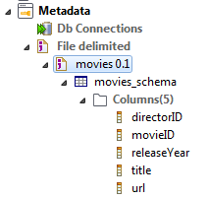
Preparing the Metadata
Click Finish to validate the schema close the wizard.
The created file metadata is shown in the Repository tree view.

Slide 18
Configuring and executing a Job – Reading CSV File
This example describes how to configure the components using the metadata created in the previous procedure and run your Job.
Procedure:
Create a new Job as readCSVFile.
It is good practice to add a purpose and a description to a Job. Then, click Finish to create your Job.
In the Repository tree view, expand Metadata > File delimited, and drag and drop the file connection movies or its schema movies_schema onto thetFileInputDelimited component in the design workspace. When asked whether to propagate the changes to the output component, click Yes.
In the Basic settings tab of the Component view, you'll find that all the parameters of the component have been automatically filled.

Slide 19
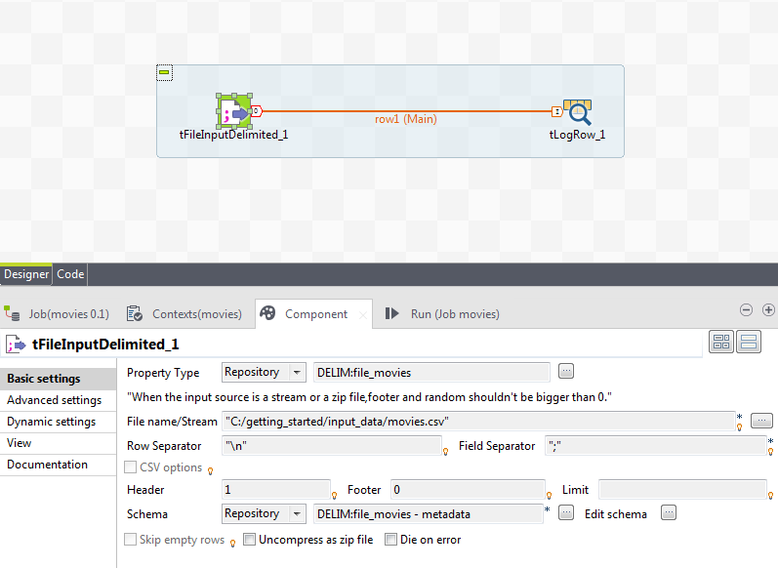
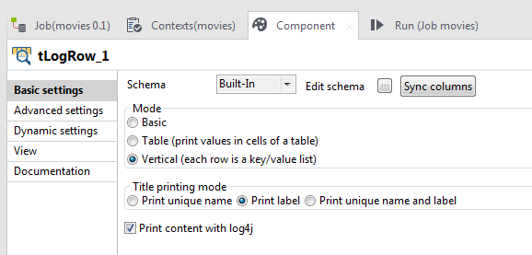
Configuring and executing a Job – Reading CSV File
Double-click the tLogRow component to open its Basic settings tab view.
In the Mode area, select the Vertical (each row is a key/value list) option for better readability of long fields on the Run console.

Slide 20
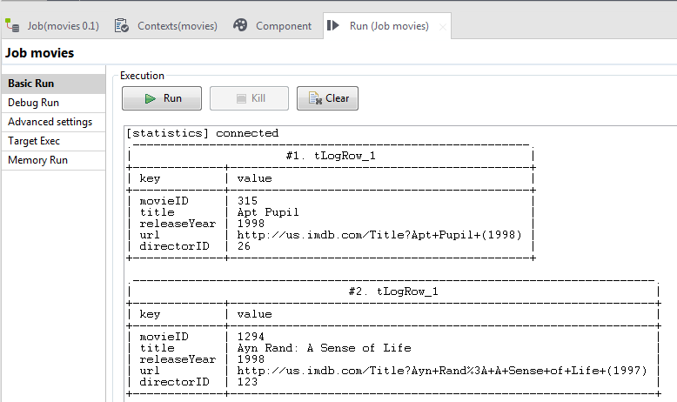
Configuring and executing a Job – Reading CSV File
Press F6 or click the Run button on the Run view to execute your Job.
Results: The Run console displays the movies information read from the source file.

Slide 21
Reading a File – Without Metadata
Procedure
Create a new Job as readAnotherCSVFile.
It is good practice to add a purpose and a description to a Job. Then, click Finish to create your Job.
Add a tFileInputDelimited component from the palette list.
Configure the tFileInputDelimited_1 component
In the Job Designer, click the tFileInputDelimited_1.
To define the Basic settings for the component, in the Component view, click the Component.
Property Type defines how you will read the data source.
Schema defines the data structure of the file.
File Name/Stream shows the complete input or output file path. You can either type the path manually or use the ellipsis button […] to provide the file path. The input file can be downloaded from Documents > Week 08 > Talend_Data > movies.csv.

Slide 22
Reading a File – Without Metadata
Row and Field Separators define the type of row (“\n”) and column (“;”) separator.
Header and Footer indicate the number of rows in the file that should be ignored.
Limit shows the maximum number of lines to read in the file.
To specify the path and name of the file to be read, click [...] next to the File Name field, select the file from the local disk, and click Open.
Define the Schema for the tFileInputDelimited_1 component
To define the schema for the tFileInputDelimited_1 component, click [...] next to the Edit schema field. The Schema of the tFileInputDelimited_1 wizard opens. [+] button adds a column to the schema wizard. [x] button removes the selected items from the schema wizard. [↑] and [↓] buttons move selected items up or down in the schema wizard.

Slide 23
Reading a File – Without Metadata
In the Schema wizard, click the [+] icon to add a column.
In the Column column, enter the field name as movieID.
To designate this field as the key, select the Key.
In the Type column, click Integer.
Ensure that the Nullable column is unchecked, so that any null value for this column is rejected.
In the Length column, enter 04.
Repeat the previous steps for each field in the CSV file.
To close the Schema wizard, click OK.

Slide 24
Reading a File – Without Metadata
Add the logging component and propagate the data
Add a tLogRow component to the Job. The tLogRow component will display in the console all the rows of data it receives.
To propagate data from the tFileInputDelimited_1 component to the tLogRow_1 component, in the Job Designer, right-click tFileInputDelimited_1, hold, and drag to tLogRow_1.
Alternative method: To link the components, you can also right-click the source component and click Row > Main
Run the Job
In the Run view for the Job readCSVFile, click Run.
The file was read by the tFileInputDelimited component, and its content was displayed on the console by the tLogRow component.

Slide 25
Filtering Information – Preparing Metadata
This scenario will extend the Job readCSVFile to filter the data flow to get only those movies with valid director information.
Preparing directors file metadata
This procedure shows how to set up the metadata of the reference file directors.txt in the Repository. This metadata item will be used to add and set up the lookup input in this scenario.
You have the source file directors.csv ready in the directory Documents > Week 08 > Talend_Data > directors.txt
Procedures
In the Repository tree view, expand the Metadata node, right-click File delimited, and select Create file delimited from the contextual menu to open the [New Delimited File] wizard.
Enter a name for the file connection, directors in this example, and other useful information to better describe your file metadata, and then click Next to go to the next step and define the general properties of the file.

Slide 26
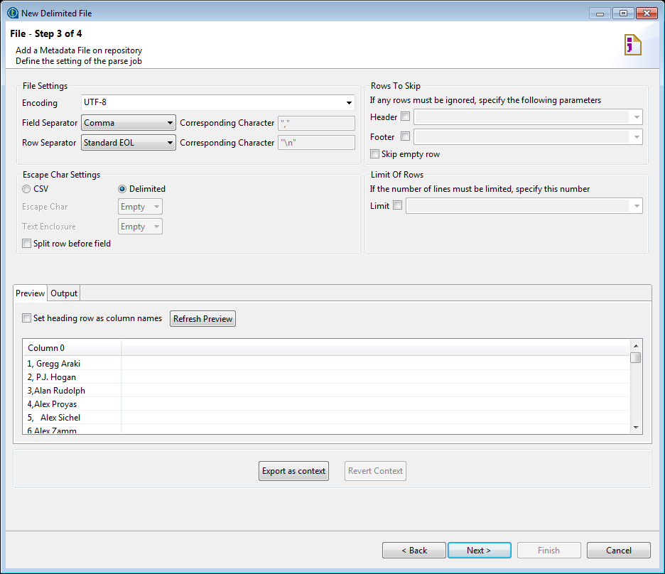
Filtering Information – Preparing Metadata
In the File field specify the path of the source file, or click Browse to browse to the file.
The file is loaded, and the File Viewer area displays an abstract of the file, allowing you to check the file consistency, the presence of header and more generally the file structure.
Select Windows from the Format list, and click Next to parse the file.
From the Field Separator list of the File Settings area, select Comma.
Click Next to retrieve the file schema.
The Description of the Schema table displays the generated file schema.

Slide 27
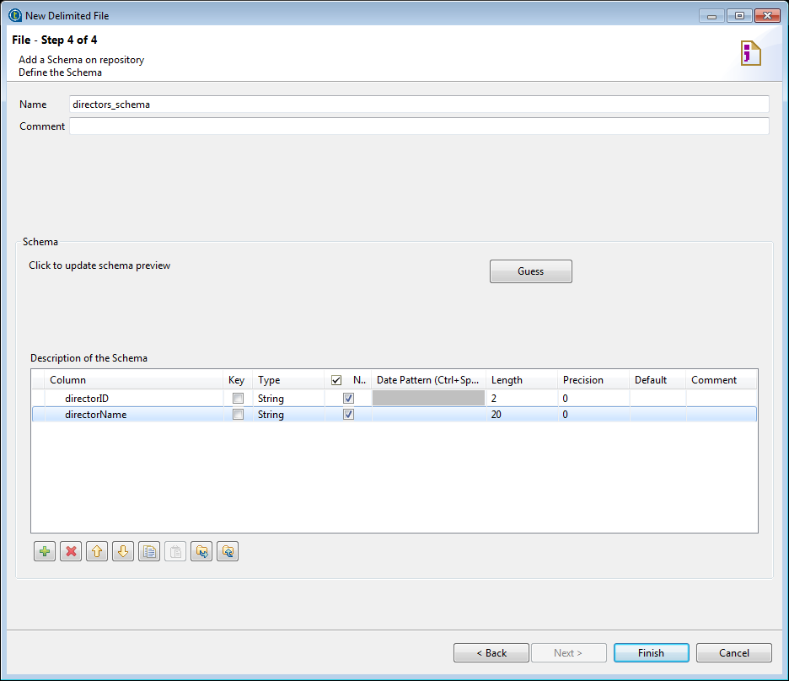
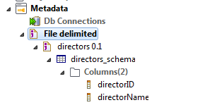
Filtering Information – Preparing Metadata
Name the schema directors_schema and rename the columns to directorID and directorName respectively, and change the data type of the directorID columns from Integer to String.
Click Finish to validate the schema close the wizard.
The created file metadata is shown in the Repository tree view.
You now have the directors file metadata ready for use when you set up the component to read the reference file.

Slide 28
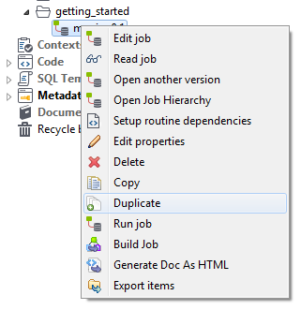
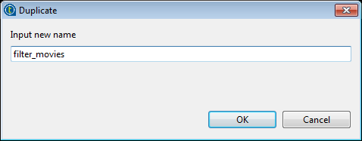
Filtering Information - Duplication
Duplicating the existing Job
This procedure shows how to create a Job based on an existing Job.
You have created and successfully executed the Job named readCSVFile.
Procedure
In the Repository tree view, right-click the Job named readCSVFile and select Duplicate from the contextual menu.
In the Duplicate dialog box, enter a name for the new Job, filter_movies in this example, and click OK to validate the Job creation and close the dialog box.

Slide 29
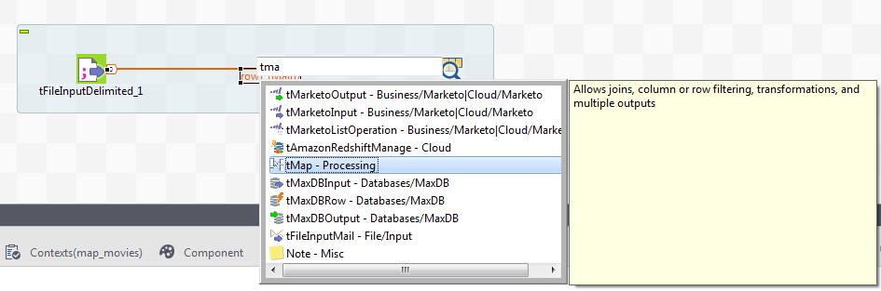
Filtering Information - Mapping
Adding a Mapping Component
The procedure below shows how to add a mapping component by typing the component name directly on the existing connection.
Procedure
In the new Job named filter_movies, select the Row connection linking the tFileInputDelimited and tLogRow components, and type name of tMap or part of it.
When you start typing the component name, a list of components that match your input appears. You can select a component to view its description besides the component list.

Slide 30
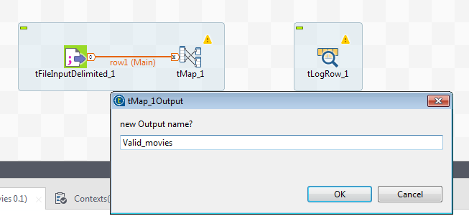
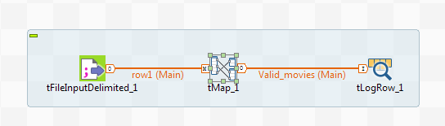
Filtering Information - Mapping
Double-click tMap on the list to added it onto the connection.
The newly added tMap component is now connected with the input component, and a dialog box opens asking you to give a name to the new output connection.
Enter a name for the new output connection, Valid_movies in this example, and click OK. When asked whether you want to propagate the input schema to the target output component, click Yes.
Results: The tMap component is now added to the Job and connected with the two existing components via Row > Main connections.

Slide 31
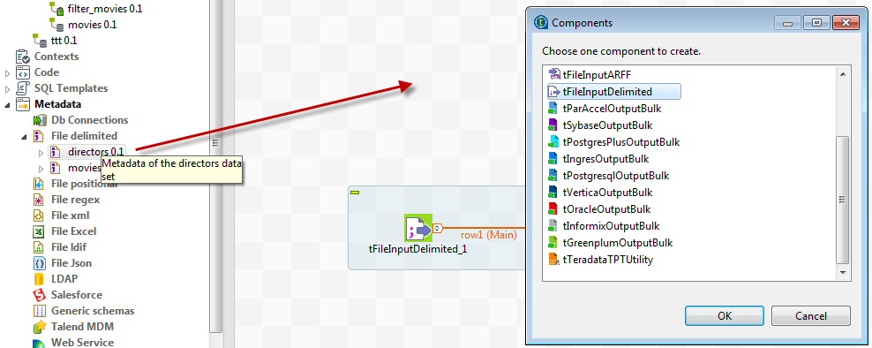
Filtering Information - Lookup
Adding a lookup component
The procedure below shows how to add a lookup input component from the Repository, connect it to the tMap, and enable column trimming in the component.
Procedure
In the Repository tree view, expand Metadata > File delimited, drag and drop the file connection directors or its schema directors_schema onto the design workspace.
The Components dialog box opens, showing a list of components you can add to the Job from this metadata item.

Slide 32
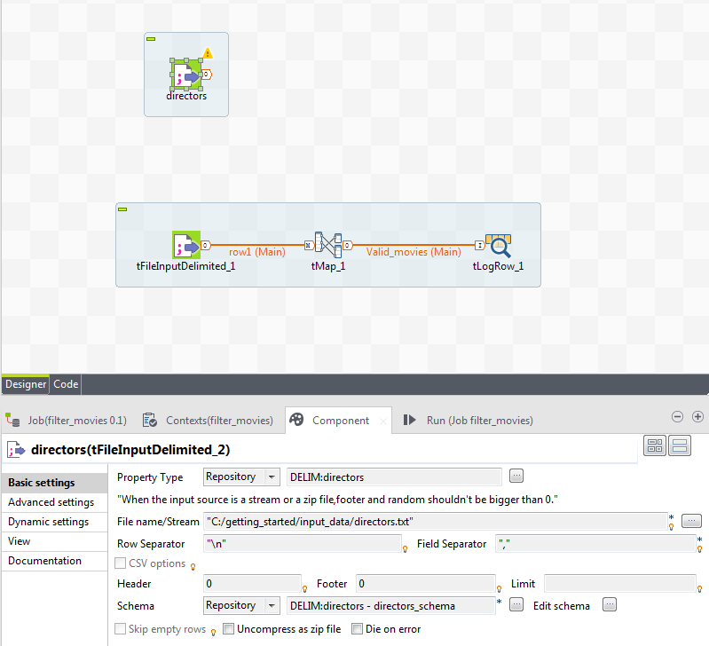
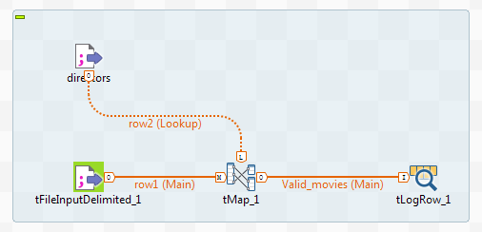
Filtering Information - Lookup
Select tFileInputDelimited and click OK.
A tFileInputDelimited labelled directors is added to the design workspace, with its basic settings automatically filled.
Right-click the newly added tFileInputDelimited component, select Row > Main from the contextual menu, and click the tMap component.
The tFileInputDelimited is connected to the tMap via a lookup connection now.

Slide 33
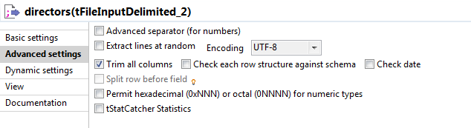
Filtering Information - Lookup
In the Advanced settings tab of the new tFileInputDelimited component, and select the Trim all columns check box.
Some records of the reference input file directors.txt contains leading white spaces. This option allows you to remove such white spaces from the lookup input flow when the Job is executed.
Results: You have now all the components in the Job needed for filtering the movies information. Next you'll need to configure mappings in the tMap component to filter the main input flow against the lookup flow and output the desired information.

Slide 34
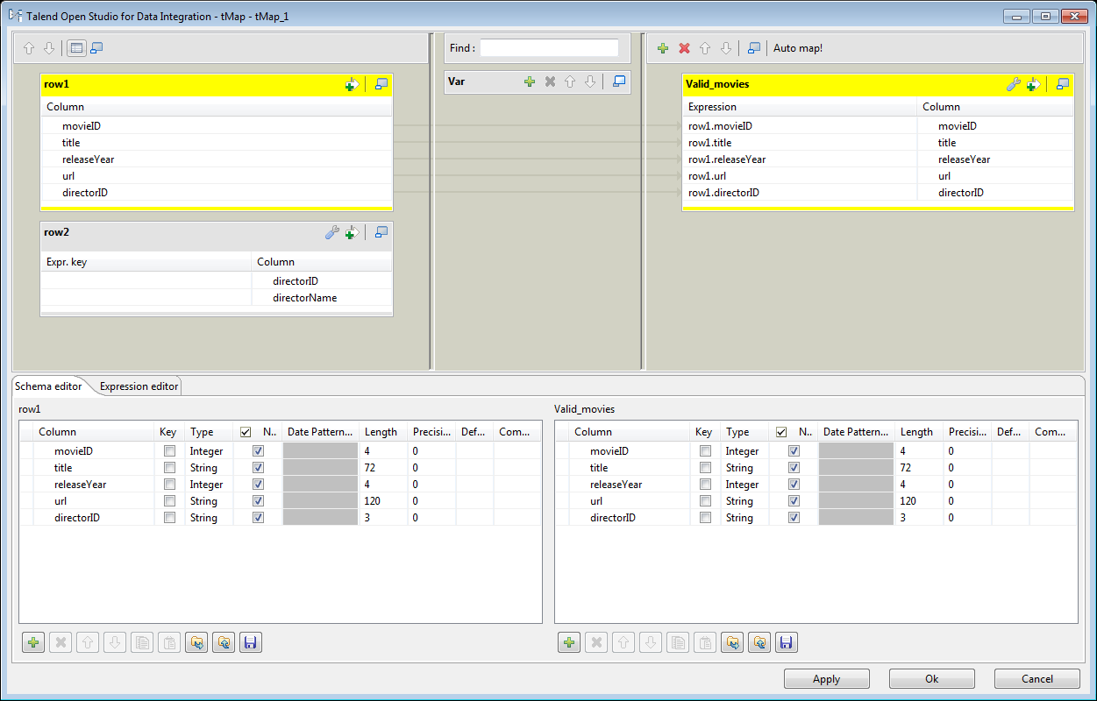
Filtering Information – Configure and Execute
Configuring mappings and executing the Job
The procedure below shows how to configure mappings and an inner join to output movies information with valid director IDs.
Procedure
Double-click the tMap component to open the map editor.
The map editor shows three tables, named row1, row2 and Valid_movies in this example, corresponding respectively to the movies file schema, the directors file schema, and the schema of the output for valid movies information, and columns in the row1 table are already mapped to the columns in the Valid_movies table.

Slide 35
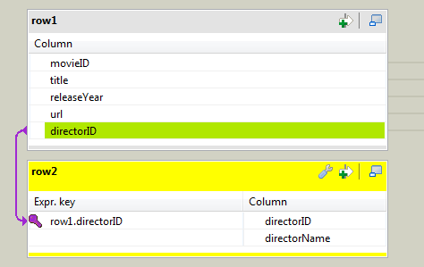
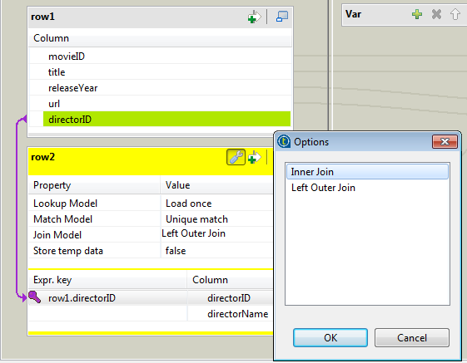
Filtering Information – Configure and Execute
Select the directorID column in the row1 table, and drop it onto the directorID column in the row2 table to create a join between the two input data sets based on the director IDs.
Click the tMap settings button, then click Value field for Join Model, and then click the [...] button that appears to open the Options dialog box. In the dialog box, select Inner Join and click OK to define the join as an inner join.
With this setting, only the movie records with the director IDs matching with those in the reference file will be passed to the output.

Slide 36
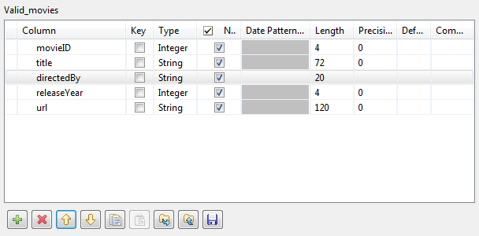
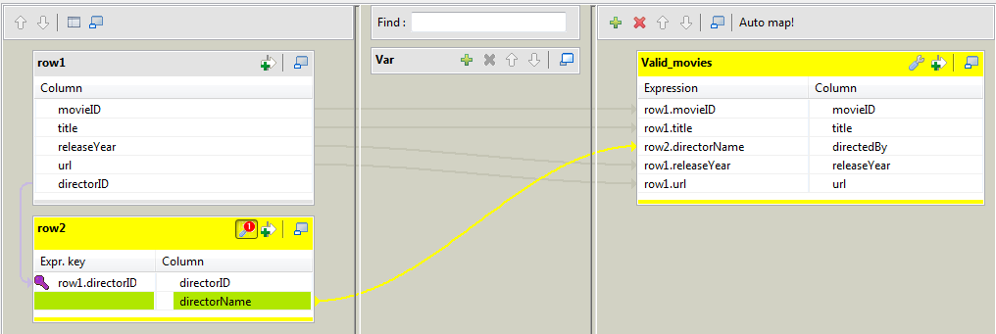
Filtering Information – Configure and Execute
In the Schema editor at the bottom of the map editor, select directorID column of the output schema, Valid_movies in this example, and click the [X]button to remove it.
Click the [+] button beneath the output table to add a new column, name it directedBy, set its length to 20, and move it up so that it's between the title and releaseYear columns.
Select the directorName column in the row2 table, and drop it to the Expression field corresponding to the directedBy column in the output table.
A new mapping is created between lookup table and the output table.

Slide 37
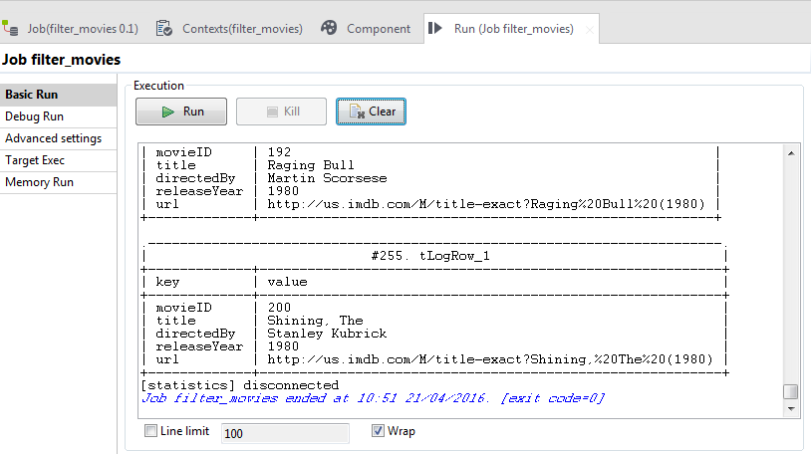
Filtering Information – Configure and Execute
Click OK to validate the mappings and close the map editor, and click Yes when asked whether to propagate the changes.
The mapping configurations are saved and the output schema is synchronized to the output component tLogRow.
Press F6 or click the Run button on the Run view to execute your Job.
Results: Only movie records with valid director information are displayed on the Run console.

Slide 38
Saving Processing Results
Based on the scenario described in Filtering Information, this scenario further extends the Job to gather movies data missing director information and writes both valid and invalid data to a MySQL database.
This scenario demonstrates:
How to add a component by typing on the design workspace or dragging from an existing component.
How to configure mappings for rejected information in tMap.
How to configure database outputs.

Slide 39
Saving Processing Results– Database Output Component
Adding database output components to your Job
In the example below we will create a new Job from the Job filter_movies and add two tMySqlOutput components. These components will be used to write the processed movies information to the specified database tables.
You have created and successfully executed the Job filter_movies.
Procedure
Create a new Job by duplicating the Job created in the previous scenario, and name the new Job write_movies_to_db, and then double-click the Job to open it in the design workspace.
Right-click the tLogRow component and select Delete from the contextual menu to delete it.
Click where the tLogRow was on the design workspace and type the name of tMySqlOutput or part of it, and then select and double-click tMySqlOutput on the list to add it onto the design workspace.
When you start typing the component name, a list of components that match your input appears. You can select a component to view its description besides the component list.

Slide 40
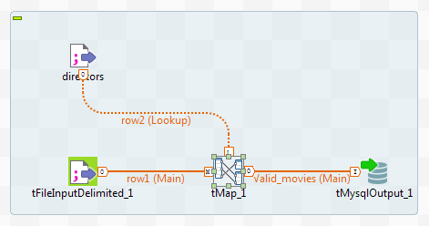
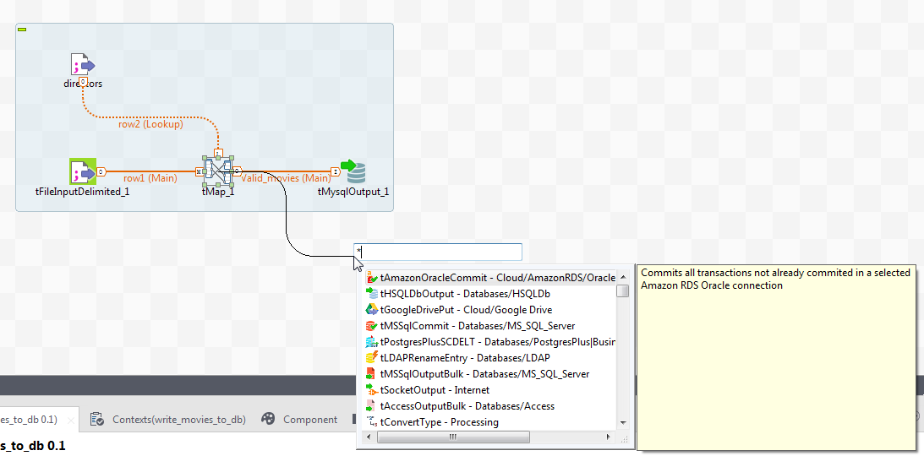
Saving Processing Results– Database Output Component
Right-click the tMap component, select Row > Valid_movies from the context menu, and click the tMySqlOutput to link it with the tMap.
The connection name Valid_movies corresponds to the name of the existing output table in tMap.
Click the tMap component, and drag and drop the o icon onto the design workspace.
A text field and a list of suggested components appear. You can select a component to view its description besides the component list.

Slide 41
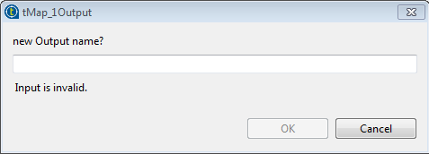
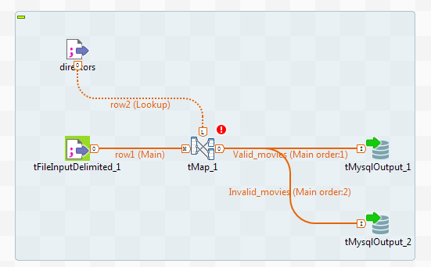
Saving Processing Results– Database Output Component
In the text field, type the name of tMySqlOutput, select the component on the list, and press Enter to add another tMySqlOutput component onto the design workspace.
A dialog box appears, asking you to enter a name for the output connection.
In the dialog box, enter Invalid_movies and click OK to connect tMap to the second tMySqlOutput component.
Results: Now you have added and connected the database output components you need to write the processed movies information to a MySQL database. Next, you'll need to configure new mappings in the tMap and database settings in the tMySqlOutput components.

Slide 42
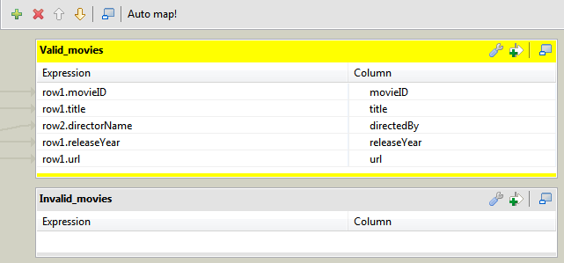
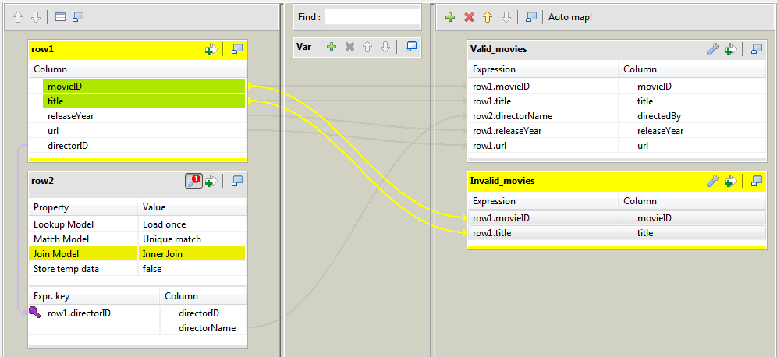
Saving Processing Result – Mapping for Rejected Data
Configuring mappings for rejected data
This procedure shows how to configure mappings to gather rejected information.
Procedure
Double-click the tMap component to open the map editor.
An second output table named Invalid_movies has been automatically created.
Drop the movieID and title columns from the row1 table to the Invalid_movies table.

Slide 43
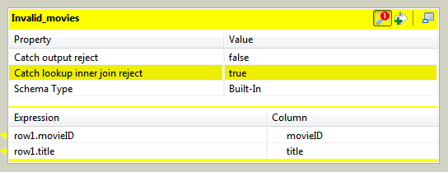
Saving Processing Result – Mapping for Rejected Data
Click the tMap settings button on the Invalid_movies table, click the Value field for Catch lookup inner join reject, and then click the [...] button that appears to open the Options dialog box. In the dialog box, select true and click OK.
With this setting, any records without director IDs or with director IDs that do not match with those in the reference file will be passed to this output.
Click OK to validate the mappings and close the map editor, and click Yes when asked whether to propagate the changes.
The mapping configurations are saved and the output schema is synchronized to the output component.
Results: Now you have configured mappings for the rejected output. Next, you'll need to configure the output components to write the output flows to database tables.

Slide 44
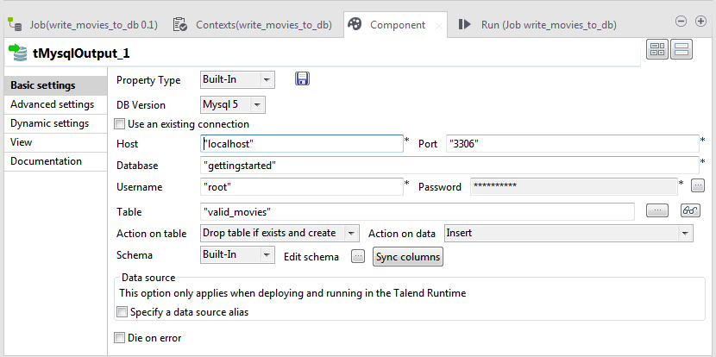
Configuring MySQL database outputs
This procedure shows how to configure database output components to write movies information to MySQL database tables.
Procedure:
Double-click the first tMySqlOutput component to open its Basic settings in the Component view.
Provide the connection details needed to access your database, including the host name or IP address, port number, database name, user name and password, in the relevant fields.
When entering your password, you need first to click the [...] button next to the Password field to open a dialog box, enter your password between double quotation marks in the text field, and then click OK.

Slide 45
Configuring MySQL database outputs
In the Table field, enter the name of the target database table.
In this example, the table for valid movies information is valid_movies.
Select the Action on table and Action on data options according to your needs.
In this example, we want to remove the table first if it already exists and then create an empty one, and use the default option for the action on data.
In the Basic settings of the second tMySqlOutput component, use the same settings as in the first tMySqlOutput except the name for the target database table.
In this example, the table for invalid movies information is invalid_movies.
Press F6 or click the Run button on the Run view to execute your Job.
Results: The movies records with valid director information are saved to the database table named valid_movies, and those without valid director information are saved to the database table named invalid_movies.

Slide 46

46
Questions?
46
Notes:
Address any questions students have from reviewing THIS MODULE, having JUST SEEN IT PRESENTED.

Slide 47

End of Module
47

